Slide 1
INTRODUCTION
TO
OPERATING SYSTEM
Presented By: MANPREET SINGH

Slide 2
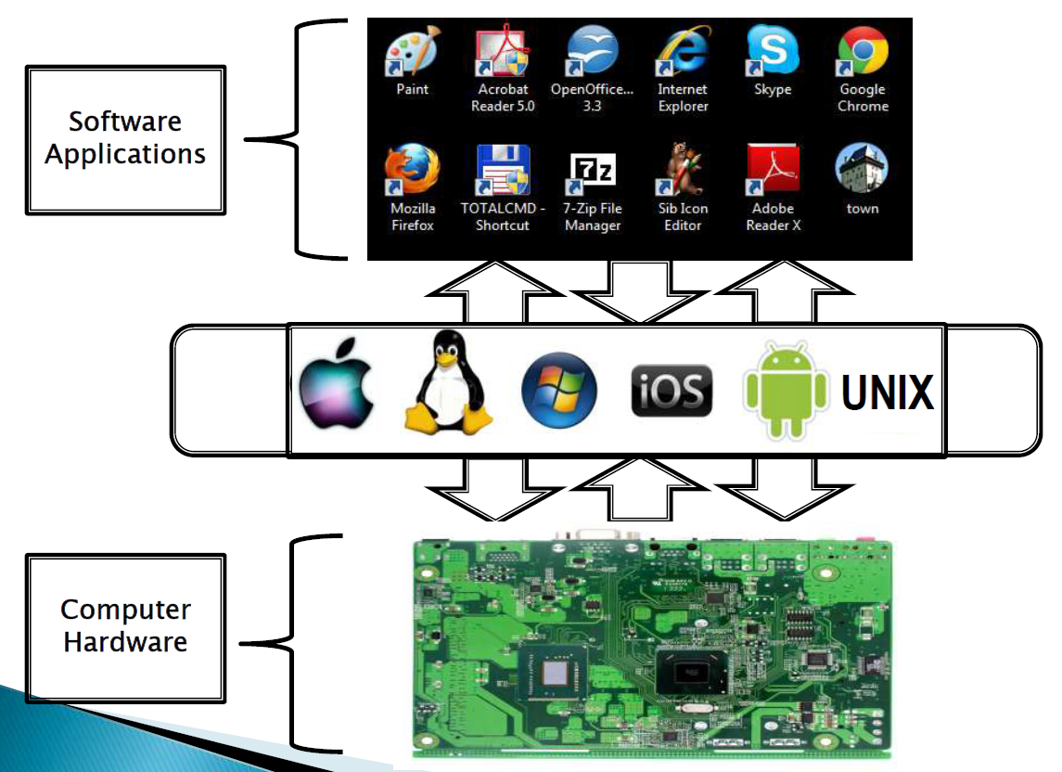

Operating System Meaning

Slide 3
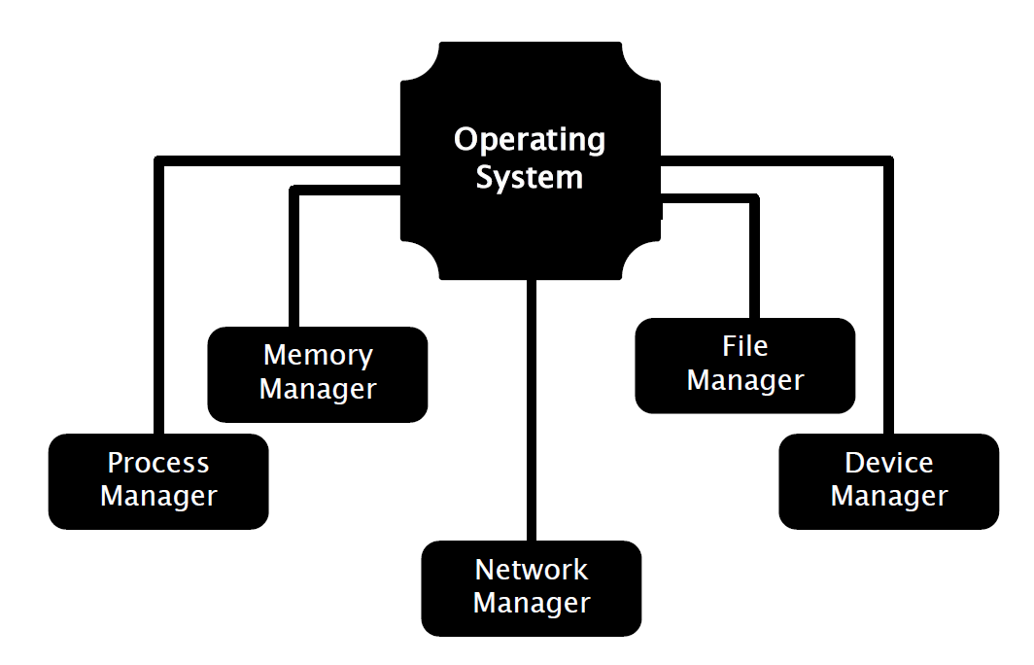
Functions of OS

Slide 4
Functions of OS
  Processor Management (process scheduling)
  Memory Management (management of Primary Memory or Main Memory)
  File Management (Keeps track of information, location, uses, status etc. The collective facilities are often known as file system)

Slide 5
Functions of OS
  Device Management (detecting and managing devices- I/O controller
  Network and Security (passwords,firewalls,antivirus

Slide 6
Views of Operating System
1. User view
  ease of use and performance.
2. System view
  Resource Manager and control program

Slide 7
MCQ:1
Who controls the execution of programs to prevent errors and improper use of computer?
a) Resource allocator
b) Control Program
c) Hardware
d) None of the above

Slide 8
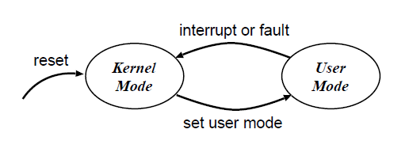
Operating-System Operations
Dual-mode operation
  User mode when executing on behalf of a user (i.e. application programs).
  kernel mode when executing on behalf of the operating system.
  Mode bit provided by hardware
    Provides ability to distinguish when system is running user code or kernel code

Slide 9

Transition from User to Kernel Mode

Slide 10
The operating system switches from user mode to kernel mode so the mode bit will change from?
a) 0 to 1
b) 1 to 0
c) Remain constant
d) None

Slide 11
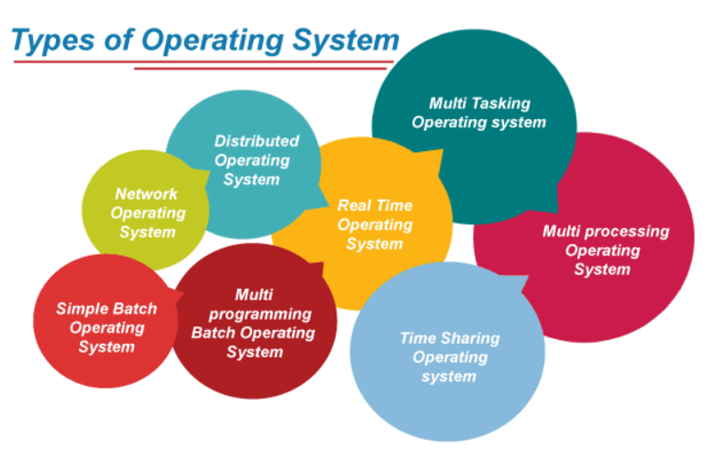
Types of OS

Slide 12
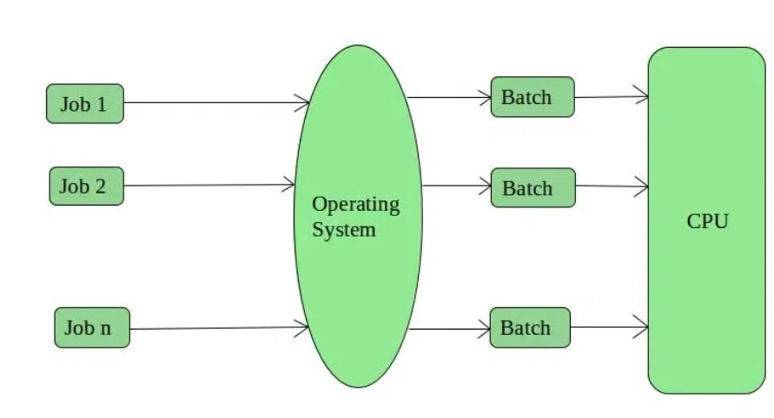
Batch OS
similar types of jobs were batched together
operating system does not interact with the computer directly.
There is an operator which takes similar jobs having the same requirement and groups them into batches.

Slide 13
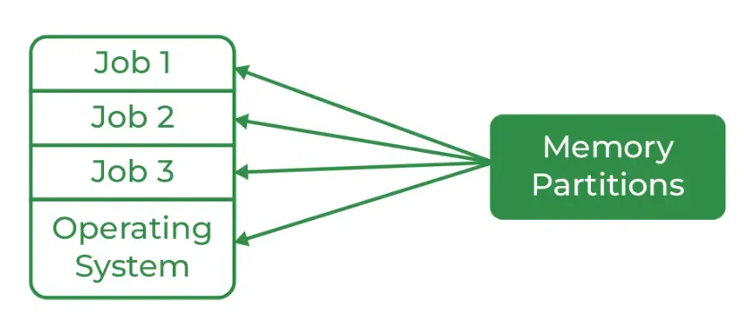
Multiprogramming OS
more than one program is present in the main memory
CPU is always kept busy
Each process needs two types of system time: CPU time and IO time.
Throughout the system, it increased as the CPU always had one program to execute.

Slide 14
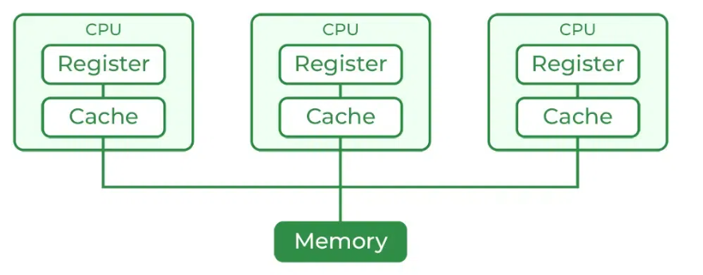
Multiprocessing OS
more than one CPU is used for the execution of resources.
Parallel computing is achieved.
This will increase the throughput of the system.

Slide 15
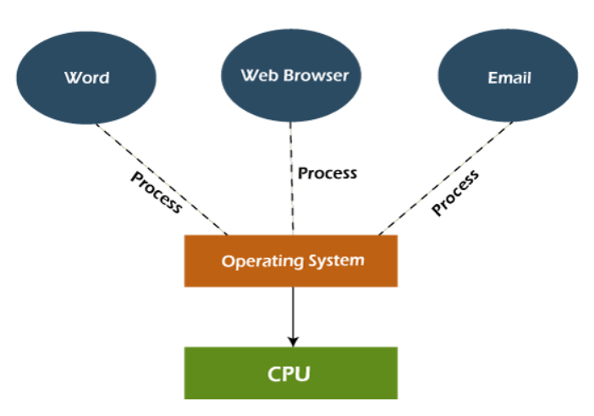
Multitasking OS
It can run multiple programs simultaneously.
It allows a user to perform more than one computer task at the same time.
having facility of a Round-Robin Scheduling Algorithm.

Slide 16
Q. What is the objective of multiprogramming operating systems?
a) Maximize CPU utilization
b) Switch the CPU among processes
c) Achieve multitasking
d) None of the above

Slide 17
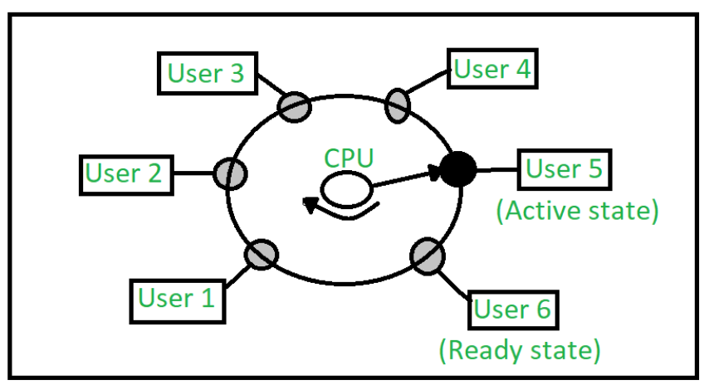
Time sharing OS
Each task is given some time to execute so that all the tasks work smoothly.
In time sharing multiple jobs are executes at the same time and the CPU switches among them so frequently that each user can interact with each program while it is running.

Slide 18
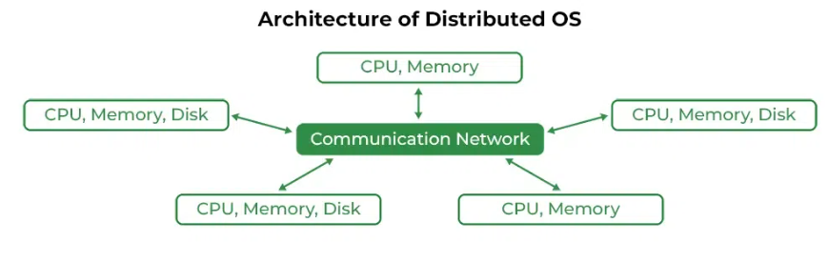
Distributed OS
various computers are connected through a single communication channel.
These independent computers have their memory unit and CPU
a user can access files that are not present on his system but in another connected system.

Slide 19
Real Time OS
In Real-Time Systems, each job carries a certain deadline within which the job is supposed to be completed, otherwise, the huge loss will be there, or even if the result is produced, it will be completely useless.

Slide 20
Real Time OS types
Real time systems are of 2 types:
1. Soft Real time Systems: Process should complete in specific time but May have some delay (Positive delay) and will nor harm the system.
Exp: Session expires but can be re-logged in.
2. Hard Real Time Systems: Each process is assigned a specific time instance, and Process must complete in that time otherwise system will crash.

Slide 21
Q. In which type of operating system users do not interact directly with the computer system?
a) Multiprogramming operating systems
b) Multiprocessing operating systems
c) Batch operating systems
d) Distributed operating systems

Slide 22
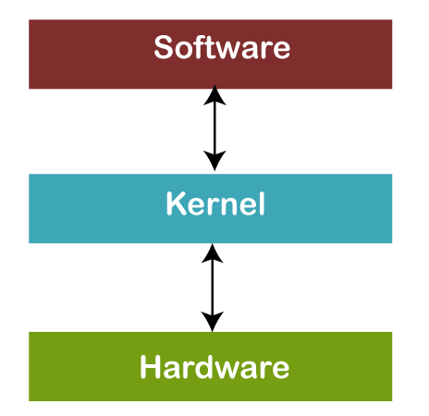
What is KERNEL?
heart of an operating system

Slide 23
TYPES
Monolithic Kernels
  In a monolithic kernel, the same memory space is used to implement user services and kernel services.
  As it uses the same memory space, the size of the kernel increases, increasing the overall size of the OS.
  The execution of processes is also faster than other kernel types as it does not use separate user and kernel space.

Slide 24
Microkernel
  In this, user services and kernel services are implemented into two different address spaces: user space and kernel space.
  the size of the microkernel is decreased, and which also reduces the size of the OS.
  there will be a greater number of system calls and context switching, then it might reduce the performance of the system by making it slow.

Slide 25
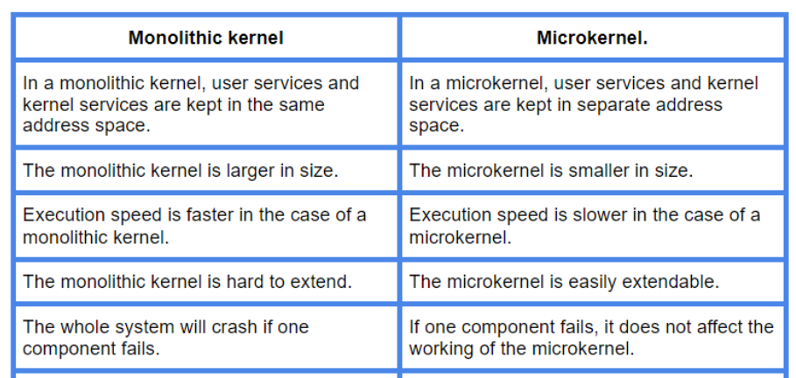

Slide 26
PROCESS
A process is a program in execution
After you write a program in any language, two steps follow:
1. Compiling
2. Running/Executing
Now, once you initiate a process, the operating system loads it into the memory (RAM).

Slide 27
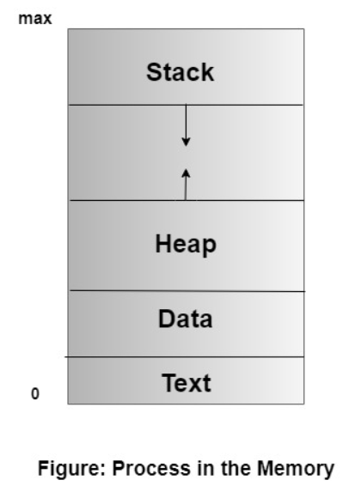
Inside the RAM the structure of the process looks like as shown below:
Text – program code
Data – contains global variables
Stack – contains temporary data
  function parameters
  return addresses
  Local variables
Heap – memory allocated dynamically during run time

Slide 28
PROCESS STATES
NEW- The process is being created.
READY- The process is waiting to be assigned to a processor.
RUNNING- Instructions are being executed.
WAITING- The process is waiting for some event to occur(such as an I/O completion or reception of a signal).
TERMINATED- The process has finished execution.

Slide 29
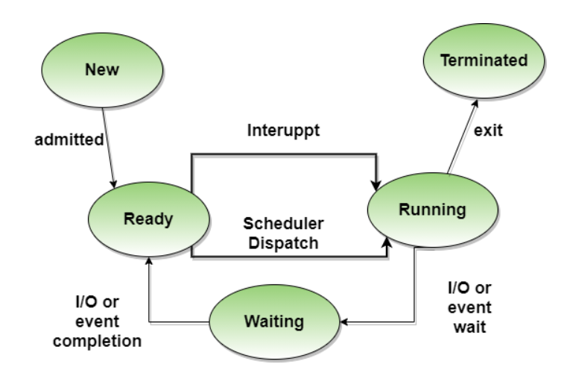

Slide 30
PROCESS CONTROL BLOCK (PCB)
A Process Control Block is a data structure maintained by the Operating System for every process.

Slide 31

Process State: It can be running, waiting, etc.
Process ID and the parent process ID.
CPU registers and Program Counter. Program Counter holds the address of the next instruction to be executed for that process.
CPU Registers: When the process is in a running state, here is where the contents of the processor registers are kept.

Slide 32
PROCESS SCHEDULING QUEUES
Job queue – comprise of all processes in the system
Ready queue – comprise of all processes residing in the main memory that are ready to run
Device queue – processes waiting for a particular device

Slide 33

Representation of Process Scheduling

Slide 34
Which of the following do not belong to queues for processes ?
a) Job Queue
b) PCB queue
c) Device Queue
d) Ready Queue

Slide 35
When the process issues an I/O request :
a) It is placed in an I/O queue
b) It is placed in a waiting queue
c) It is placed in the ready queue
d) It is placed in the Job queue

Slide 36
Schedulers (selection)
a scheduler selects one out of many available processes for execution by the CPU.
Types of Schedulers
Long Term Scheduler (LTS)
Short Term Scheduler (STS)
Medium Term Scheduler (MTS)

Slide 37
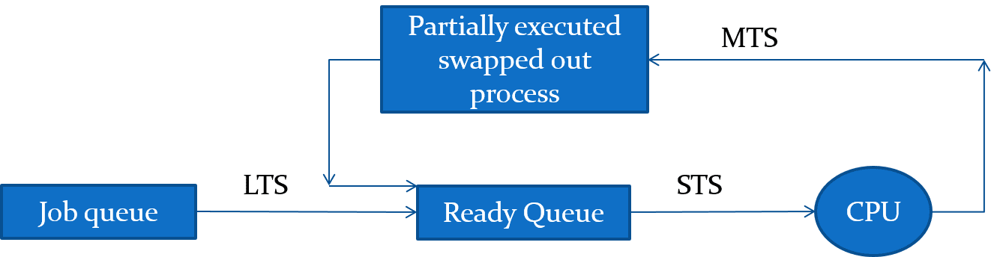

Slide 38
Context Switch
When CPU switches to another process, the system must save the state of the old process and load the saved state for the new process

Slide 39
Operations on Process in OS
1. Process creation
  A process uses a System call to create a child process.
  The operating system allocates the resources to the child from the set of resources available in the system.
  The parent process Continues to execute concurrently with its children
  The parent process Waits until some or all the children terminate.
  Is a duplicate of the parent process – which means that the child process will also have the same code as the parent process.

Slide 40
Process Termination
Normal termination
  A process finishes executing its final statement. All the resources allocated to it are freed by the operating system.
Forced Termination
  Child exceeds its usage of resources
  Task assigned to the child is no longer required
  Parent exits and OS does not allow child to run if parent terminates

